Slide 1
Brand stories going wrong in First to file Jurisdictions.
Presentation by:
Harsh Aggarwal, In House Counsel,
Havells India Limited.

Slide 2
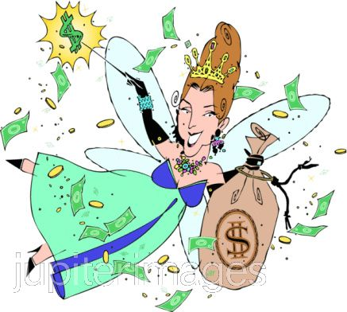
Scope of Presentation

Slide 3
What is Fairy Tale scenario?
A global company owning mark ‘X’ is comfortably doing business in a FTF jurisdiction.
It is enjoying:
trans border reputation;
decades of use;
A company owning mark ‘Y’ is comfortably doing business in its home country.
Mark ‘Y’ is a well known brand in its home Country.

Slide 4
Fairy Tale turns into a Scary Tale
Brand owner of X comes across a prior bad faith registration for:
a mark deceptively similar to it.
a mark identical to it to whose registration is prior in time by few days or weeks
Brand Owner challenges offender’s bad faith registration.
The offender in a counter action challenges the registration of the brand owner.
The offender succeeds in getting brand owners registration cancelled.
Brand owner of Y wants to expand its business in FTF jurisdiction
Brand owner applies for registration and comes across a prior bad faith registration for a mark identical to it and his applications fails.
A Fairy tale becomes a scary tale!!

Slide 5
Expectation of a Fair Trial in FTF Jurisdiction
Respect for Trademark rights of others Vs. Squatter
Honest Registrant Vs. Dishonest Registrant
Coined Mark Vs. Copied mark
Prior User Vs. later /Non Use
Global use Vs. Local Use
Trans border reputation Vs. No or negligible reputation
Global Sales Vs. Local Sales
Global Registrations/applications Vs. Only Local registration or Applicant.
On line presence Vs. only offline local presence
Wide product range Vs. limited products
Global Advertisements and promotion Vs. Negligible promotion
Quality Guaranteed Vs. Quality Questionable
Genuine Products Vs. Counterfeit/Non genuine Products
Correct source of products Vs. Misrepresentation and Misleading public

Slide 6
THANK YOU

