Slide 1
FEDRALISM IN NEPAL
SOUTH ASIAN PERSPECTIVE
SAARC Law Conference
Presented by
Dr. Surya Dhungel
Professor/Senior Advocate
march 2016 , Nepal

Slide 2
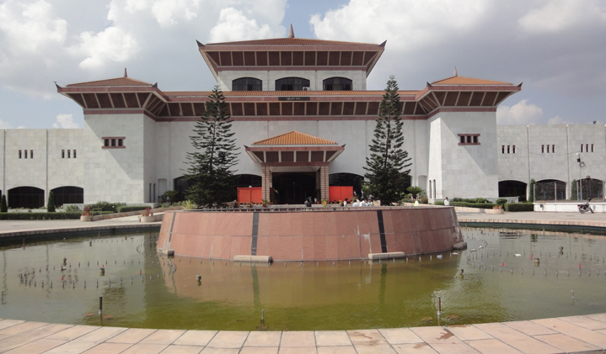
Presentation has three parts
Federal Notion and Design
Intergovernmental Relations
Strengthening Federal System: Challenges and Prospects

Slide 3
FEDERAL NOTION
Multiple Orders of Government: Vertical and Horizontal
Governance through ‘Self Rule and Shared Rule’
Constitutionally Defined Sources of Power for Each Level of Governments.
Goals: End of Discrimination; Creation of an Egalitarian Society; Management of Diversity; Empowering People and Development (Well specified in Nepal, not in other countries)
Mechanisms: Inclusive Representation; Devolution of State Powers and Autonomy; Institutional Negotiation, Collaboration, Cooperation, Coordination and Accommodation
Precondition: Democracy and the Rule of Law
Comparative Notions: Each Federation is Unique and Different; NEPAL’S approach is different from India and Pakistan. Federalism is a basic feature in India (SR Bomai Case, 1994). Nepal and India are secular, Pakistan is an Islamic Republic

Slide 4
__________________
FEDERAL STRUCTURE (Design):
Three Tiers of Government: Federal, Provincial and Local (mainly two tiers in other countries) with Provisions of Special (Protected) Areas, Autonomous Regions
Five Lists of Competencies: Three Exclusive and two Concurrent Lists (varies from country to country)
Republicanism and Parliamentary System
Basis for Creating Federations (Identity, Viability…): Interim Constitution in Nepal and Government of India Act 1935 in India and Pakistan (British Gift)

Slide 5
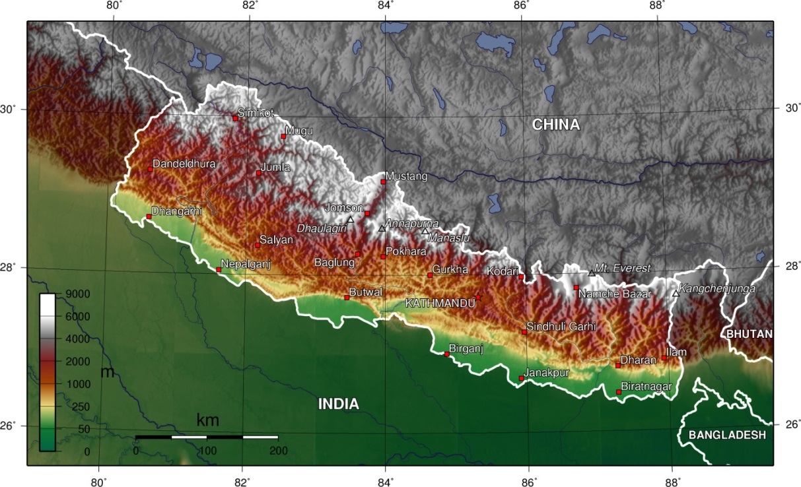
FEDERAL NEPAL- SEVEN PROVINCES, 26.6 ml Population, full of resource and cultural diversities (125 ethnic groups, over 100 languages/ dialects)… …

Slide 6
__________________
INTERGOVERMENTAL RELATIONS (Articles 231-237, Part-20):
1. Vertical and Horizontal Relations (Legal, Political, Social and Economic)
2. BASIS OF INTERRELATIONSHIP: Principles of cooperation, coexistence, coordination and collaboration
3. Mechanisms: Legislative, Executive, Judicial and other (Formal and Informal)
4. Federalism is an evolving process and reforms are made through experiences

Slide 7
___________________
LEGISLATIVE MECHANISM
EACH LEVEL OF GOVERNMENT HAS EXCLUSIVE LEGISLATIVE POWER AS STATED IN SCHEDULES 5-9 (Article 57)
SHARING OF POWER BETWEEN CENTRE AND PROVINCES (Article 231)
RESIDUARY POWER WITH THE CENTRE (Article 58)
FEDERAL PARLIAMENT MAY PASS LEGISLATION FOR COODINATION AND COOPERATION BETWEEN UNITS (Article 235)
PROVINCIAL LEGISLATURE MAY PASS LAWS FOR MAINTAINING GOOD RELATIONS BETWEEN MUNICIPALITIES AND RESOLVING LOCAL POLITICAL ISSUES (Article 235)
NATIONAL ASSEMBLY AS REPRESENTATIVE INSTITUTION OF PROVINCIAL AND LOCAL UNITS (8 MEMBERS FROM EACH PROVINCE)(Article 86).

Slide 8
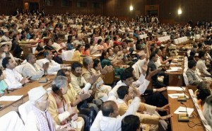
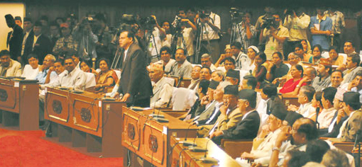
EXECUTIVE MECHANISM
CENTRE DOMINATED RELATIONSHIP; PRIMACY OF THE CENTRE
FEDERAL GOVERNMENT’S DIRECTIVES MANDATORY FOR OTHER UNITS TO COMPLAY WITH (Article 232)
PRESIDENT HAS POWER TO WARN, SUSPEND AND DISMISS PROVINCIAL GOVERNMENT (Federal parliament has to endorse within 35 days, elections within 6 months)
PROVISION OF INTERPROVINCIAL COUNCIL HEADED BY PRIME MINISTER TO RESOVE POLITICAL ISSUES.

Slide 9
JUDICIAL MECHANISM
1. Judiciary (Court System) Restructured (Article 127);
2. Constitutional Court/Bench at the Highest Level Created-
to interpret Constitution and test constitutionality,
to resolve jurisdictional disputes of competencies between federal units,
to resolve electoral disputes related to federal and provincial elections, and also with regard to disqualification of candidates (Articles 133, 137, 237)

Slide 10
OTHER MECHANISMS (Formal and Informal)
1. FORMAL MECHANISMS (CONSTITUTIONALLY BASED):
Creation of Commissions to Manage Societal and Fiscal Issues including that of identity and social justice (Articles 250-265)
Power to Create Local Judicial Committee at the Municipality Chaired by Deputy Mayor to Resolve Issues falling under local jurisdiction (Article 217)
Inter-provincial relationship to cooperate each other to implement decisions, to resolve issues through consultations and information sharing, and ensure protection/security through equal application of laws to inhabitants of other provinces (Article 233)
Cooperation and non-obstruction to promote inter-provincial trade, transportation etc (Article 236)
2. Other avenues, institutions, and learning from other federations

Slide 11
Challenges and Scope For Strengthening Federation
CHALLENGES: Transition from a Functional Unitary State to a New Complex Federal System. All Federations are Different
Learning from other federations but in the interest of the country; steps for implementation; an expensive venture, and time taking
Ensuring unity in diversity through tactful management of different aspects of cultural, geographical and economic diversities
Mitigating discriminations and ensuring social justice
Issue of legitimacy, resolving disputes over demarcation and federal design
CONSTITUTIONAL COMMITMENT with FIRST AMENDMENT, a positive step. Open and informed dialogues; democratic practice
Reforms in India through Judiciary and Amendments; Reforms in Pakistan through 18 th. Amendment in April 2010.

Slide 12
POSITIVE DEVELOPMENS
Promulgation of a Federal Republic Constitution (with first amendment opening new space), Institutionalization of Rule of Law and Federal Constitutional Order, and Local Governance System
End of conflict: establishment of peace, political stability, human rights and rule of law culture in society. Respect for constitutionalism.
Gradual devolution of power for socio-economic and political empowerment of youths, women and the grassroots people under a new federation
Move towards more information and knowledge based competitive economy.
New Drive for Social justice, egalitarianism and inclusivity
TOWARDS A COMPETTITIVE FEDERALSIM with powerful units

Slide 13
Thanks

